Slide 1
AstroSage Customer Care Investment Proposal
Project: AstroSage Customer Care Center Analysis
Presented by: Manas
Date: July 2025

Slide 2


Project Objective
Analyze performance across 4 customer care products
Identify gaps and growth opportunities
Justify ₹1 crore investment to scale AstroSage

Slide 3


Data Overview
🗂️ Data Sources:
Total Table: Guru-wise metrics (calls, chats, revenue, profit, ratings)
Row Data Feed: Raw call/chat session data including satisfaction and durations
MTD & YTD Pivot Table: Monthly and yearly revenue data
Guru Pivot Table: Consultation volumes across months and types
Dashboard Sheet: Reserved for visual summaries
📊 Key Fields:
Guru Name, Revenue, Profit, Rating, Call/Chat Connected %, Repeat Call Count
Operational Costs, Call Durations, Satisfaction Rating

Slide 4
📅 Time Period:
Major activity seen in December 2023 with 2023-24 yearly revenue records
🎯 Purpose of the Data:
Evaluate Guru performance
Compare Call vs Chat conversions
Analyze user satisfaction and profitability
Build ROI-based investment recommendation

Slide 5

Chat accounts for 69.6% of total activity
Over 60% of calls fail or go unanswered
51.1% are one-time users; 48.9% are repeat users
Guru ratings vary widely; top performers average 7.5/10
Key Insights
Tip
.We Should Work On Our Connectivity, Have To Improve Our connectivity and Guru Rating Is So Bad We Have To Improve On That Parameter As Well As.

Slide 6


Problems Identified
Area | Problem | Impect
Call Center | High Failure Rate | Poor Customer Experience
Chat Support | Incomplete interactions | Low Satisfaction
User Retention | High one-time use Ratio | Revenue instability
Guru Ratings | Rating Disparity | Inconsistent service

Slide 7
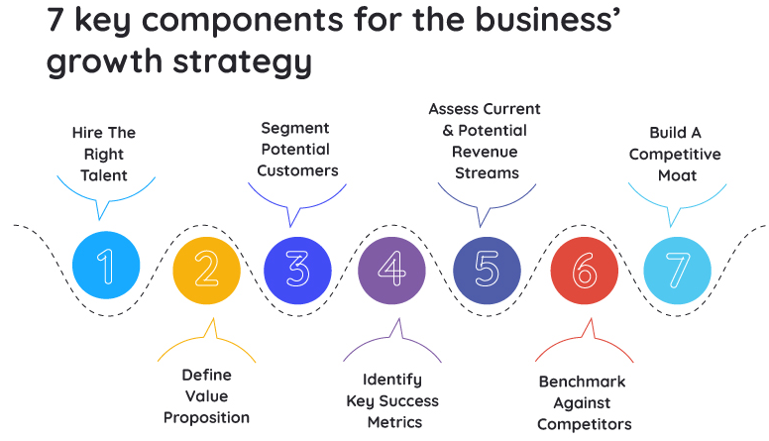
Upgrade call routing tech to reduce failures
Train chat agents for better resolution
Launch loyalty programs to retain users
Upskill low-rated gurus to improve service
Solutions & Recommendations

Slide 8

Investment Allocation Plan
Area | Budget | Purpose
Tech Infrastructure | 30 Lakhs | Call/Chat System Update
Training Programs | 20 Lakhs | Guru & Agent Development
Marketing & Retention | 30 Lakhs | Loyalty Campaigns,CRM
Data Analytics | 20 Lakhs | Performance Tracking Tools

Slide 9

Projected Outcomes
25% increase in call success rate
30% improvement in chat resolution
15% boost in repeat user ratio
20% uplift in guru ratings

Slide 10
Visualizations
Pie chart: Channel usage breakdown
Bar graph: Call vs. chat success rates
Line chart: User retention trends
Guru rating leaderboard

Slide 11
Chat vs Call Performance Guru ID Wise
Invite questions and feedback
Chat connect % is low: ranges from 5% to 32%
Calls have higher connect % and satisfaction
Chat optimization needed to increase conversions

Slide 12
Regional Analysis – Data Limitation & Insight
✅ Observation:
The dataset contains very limited Region data. Most calls and chats have blank or missing region values. Only one region is mentioned in the available data.
⚠️ Challenge:
Due to missing region info, we cannot analyze performance by geography.
This limits our ability to target specific regions for investment or marketing.

Slide 13
💡 Recommendation: Make “Region” a mandatory field in call/chat sessions. Integrate region data from user registration forms or app analytics. This will help in geo-targeted campaigns and better resource allocation.
🎯 Opportunity:
If region data is captured properly, we can:
Identify high-value regions
Launch region-specific promotions
Allocate Gurus based on region-specific demand

Slide 14
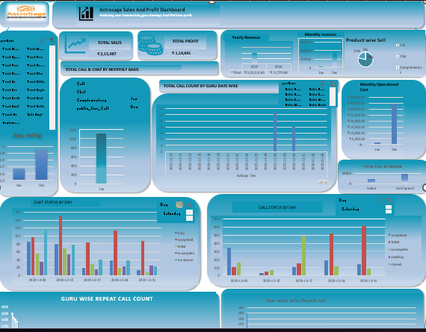
Complete Dashboard To Analyse The Data

Slide 15
AstroSage has strong potential with strategic investment
₹1 crore will address key operational gaps
Expected ROI through improved satisfaction and retention
Conclusion

Slide 16
Data shows clear trends in top-performing Gurus and chat/call engagement.
₹1 crore investment plan focuses on:
Guru retention
Skill development
Chat system improvement
Seasonal marketing (e.g., December)
Tech and support enhancement
🪜 Next Steps:
Approve Investment Allocation
Implement Guru Performance KPIs
Launch Chat UX Upgrade Project
Plan December Marketing Campaign
Monitor ROI Monthly

Slide 17


“Any Questions?”
Thank you for your time!
I’m happy to take your questions.
Let’s discuss how we can make this investment work for AstroSage’s growth.

